Slide 1

Software Testing Project
Group : ALX2_SWD6_G3-G5
Supervisor : ENG/Hussein Ali
Team Members:
1- Abdelrahman Ali
2- Ahd Ali
3- Omnya Farag
4- Shaimaa Hassan
5- Wessam Alwy

Slide 2

Welcome to our presentation on a multi-faceted software testing project. We'll explore manual, API, and automation testing techniques across diverse platforms.

Slide 3
Manual Testing:
on Learning Management System (LMS)
Objective
Scope
Approach
Ensure LMS functionality and user experience through manual testing.
Cover all user interactions, from registration to course completion.
Systematic test case design, execution, and defect reporting.
* You can view the manual test cases on our GitHub repository:
[ https://github.com/AhdAly/ALX2_SWD6_G3-G5/blob/main/G5.xlsx ]

Slide 4
Test cases analysis:
Test cases | pass | fail
23 | 18 | 5

Slide 5
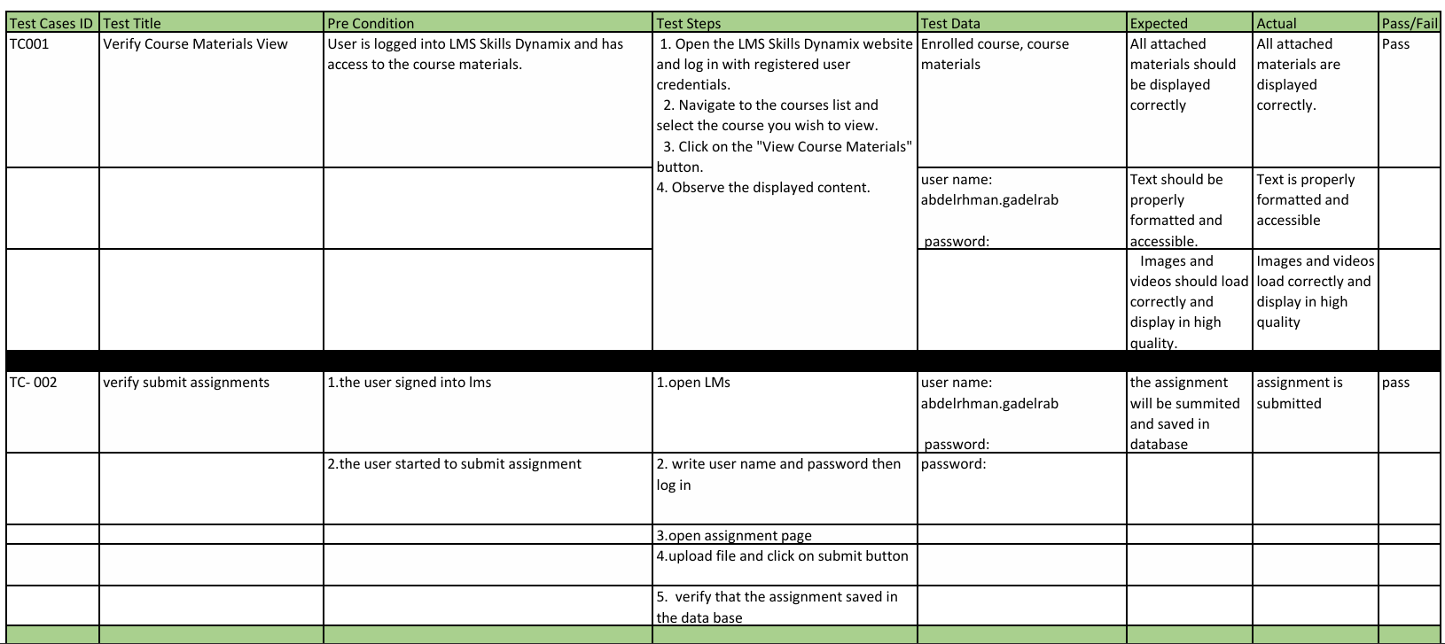
Test Cases Report :

Slide 6
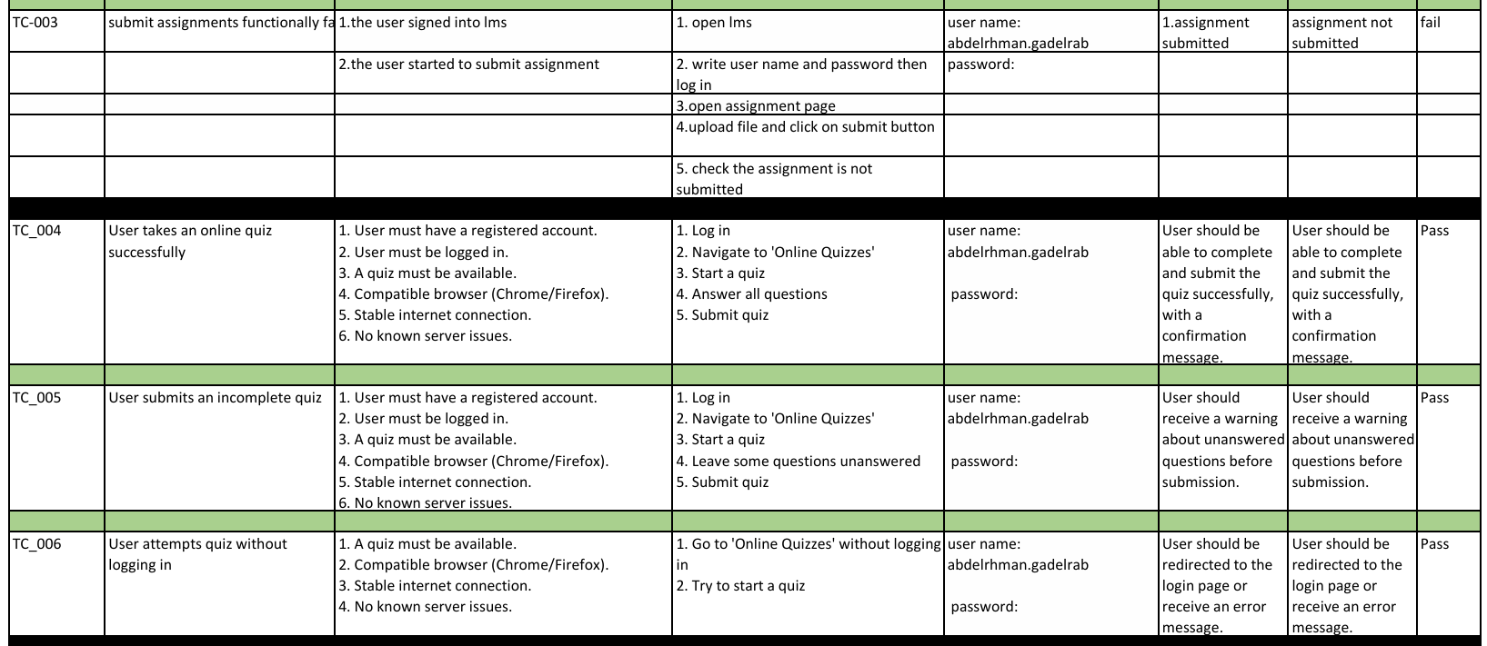
Test Cases Report :

Slide 7
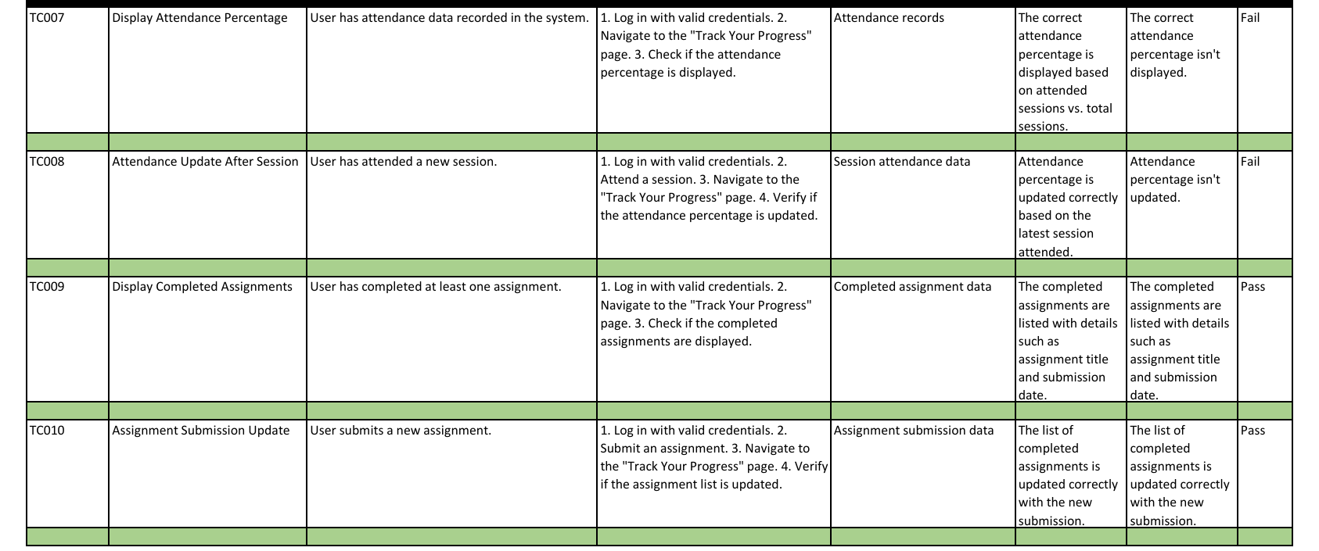
Test Cases Report :

Slide 8
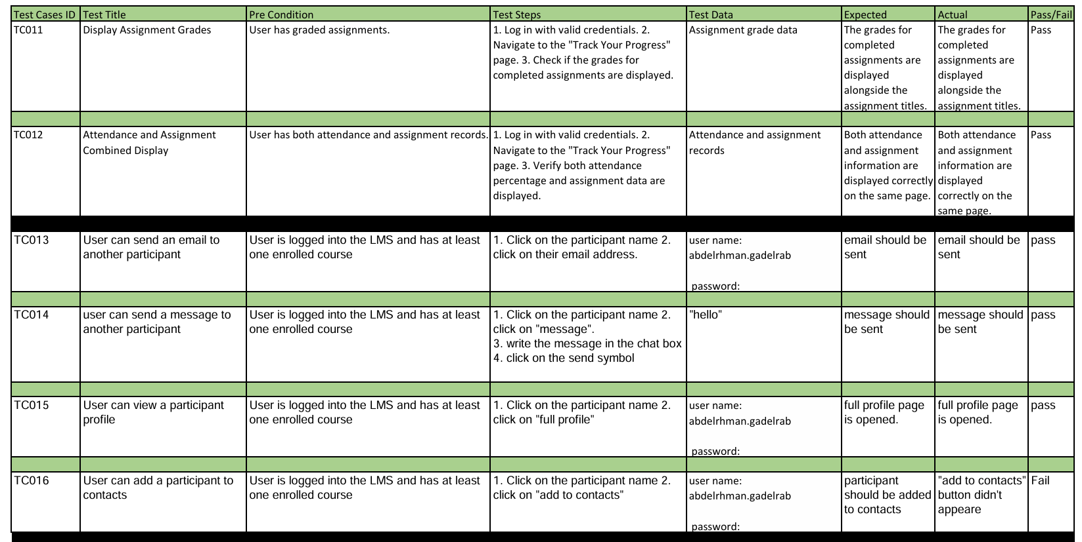
Test Cases Report :

Slide 9
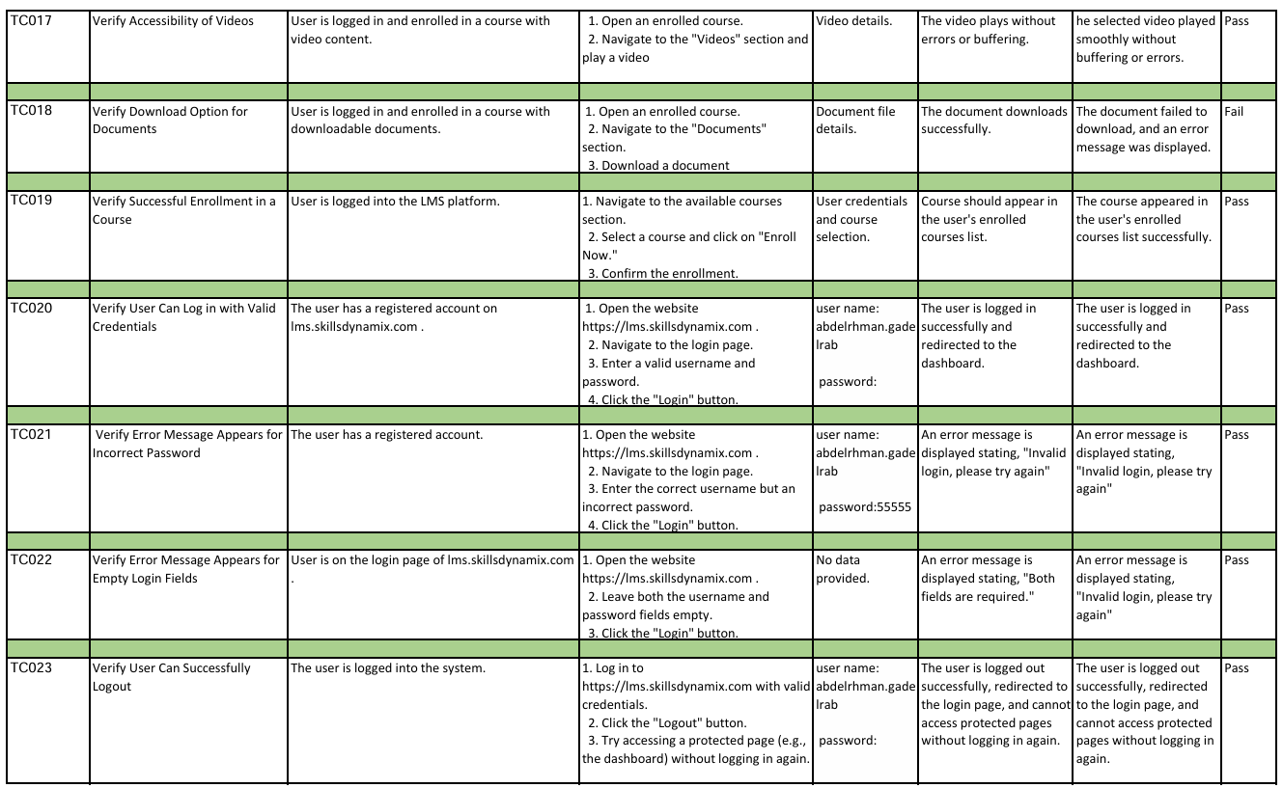
Test Cases Report :

Slide 10
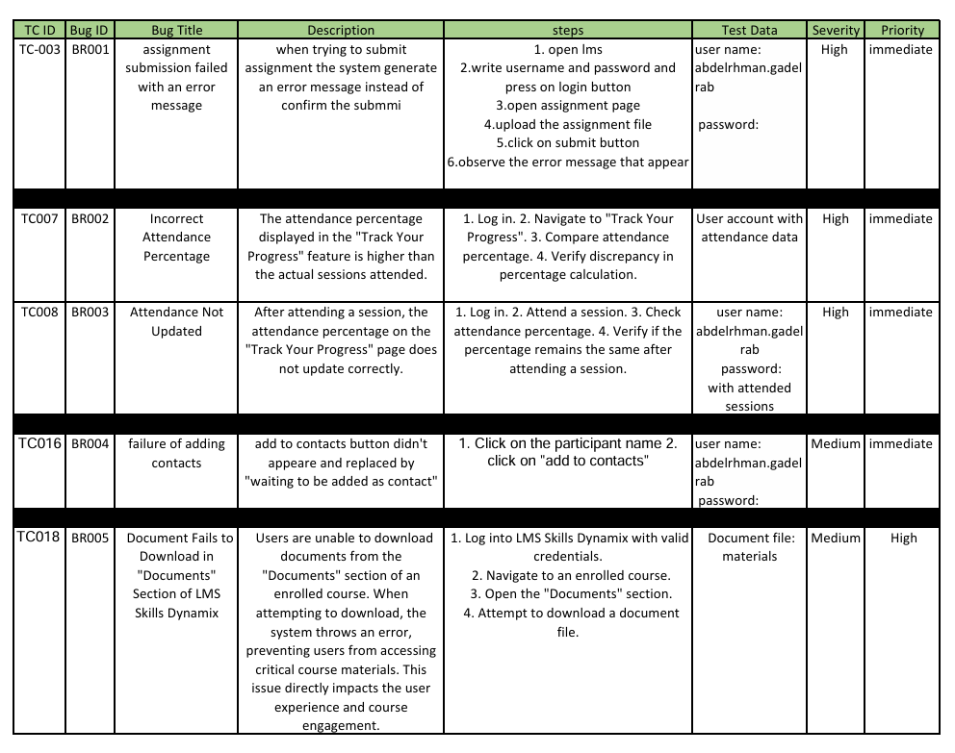
Bug Report :

Slide 11

API Testing: REST APIs
Endpoint Validation
Performance Check
Verify correct functionality of all API endpoints.
Measure and analyze API response times under various conditions.
Security Testing
Ensure APIs are protected against common vulnerabilities and exploits.
* Data Validation using Postman

Slide 12
Status Code Validation
Status Code
Meaning
Test Scenario
200
OK
Successful request
400
Bad Request
Invalid input data
404
Not Found
Resource doesn't exist
500
Internal Server Error
Server-side issue

Slide 13
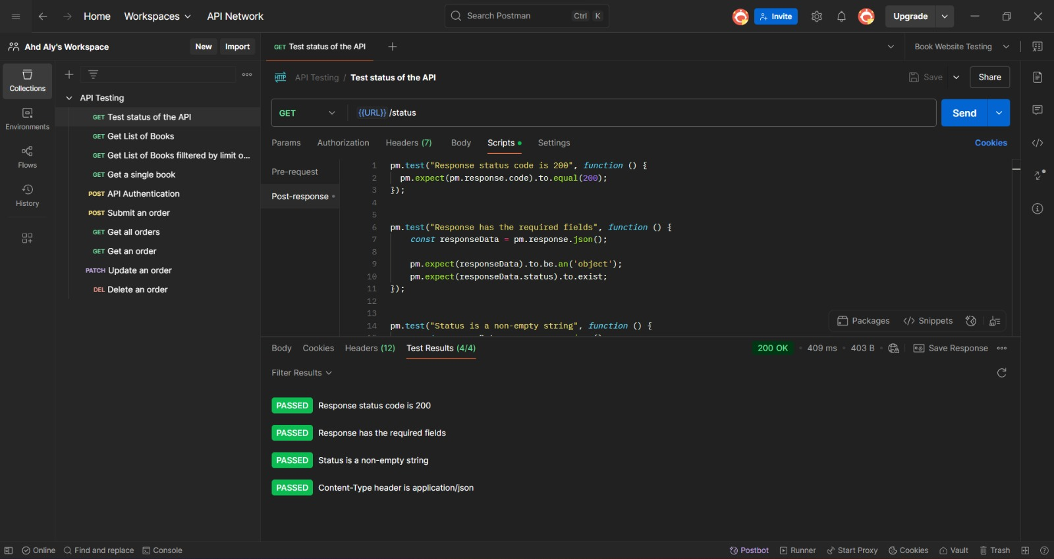

Slide 14
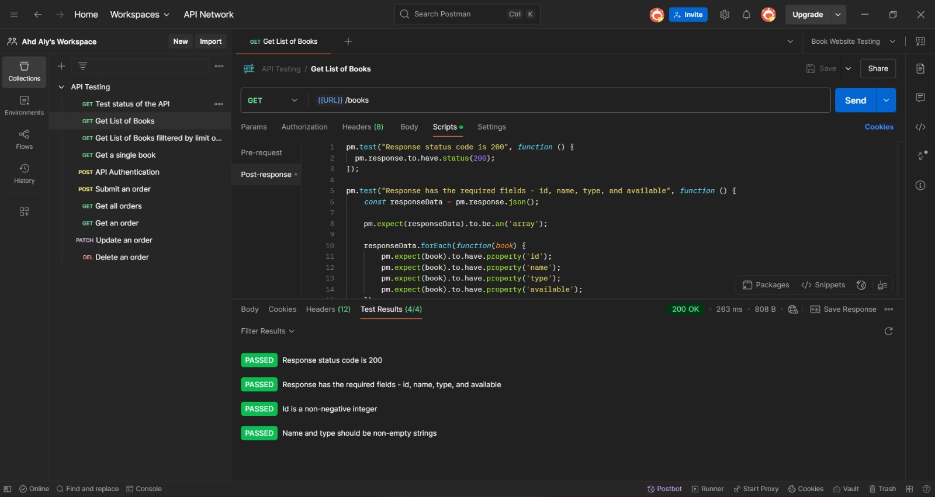

Slide 15
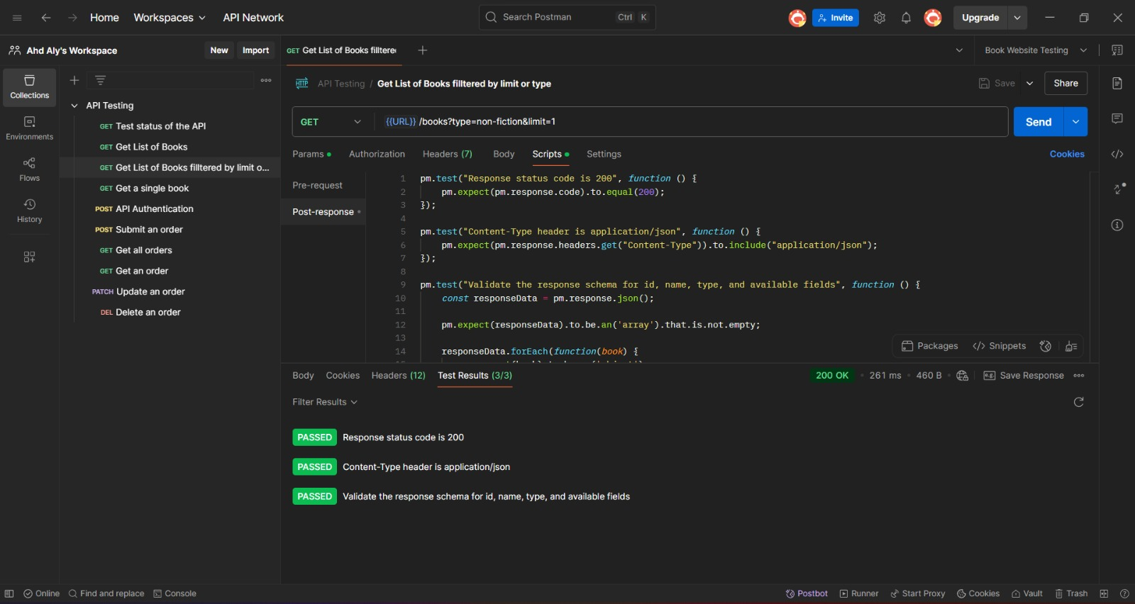

Slide 16
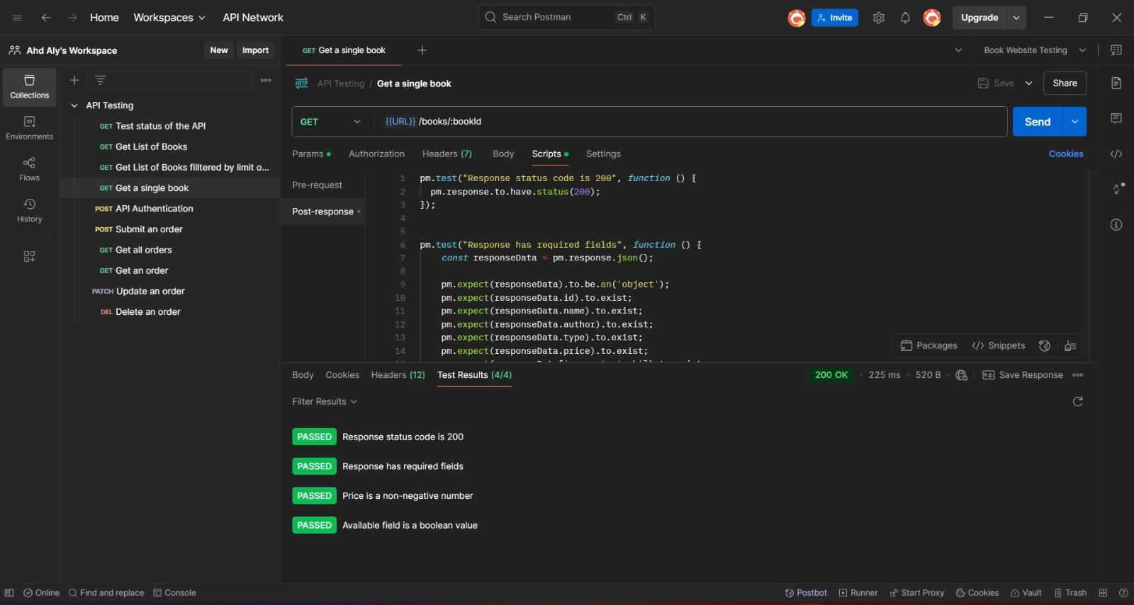

Slide 17
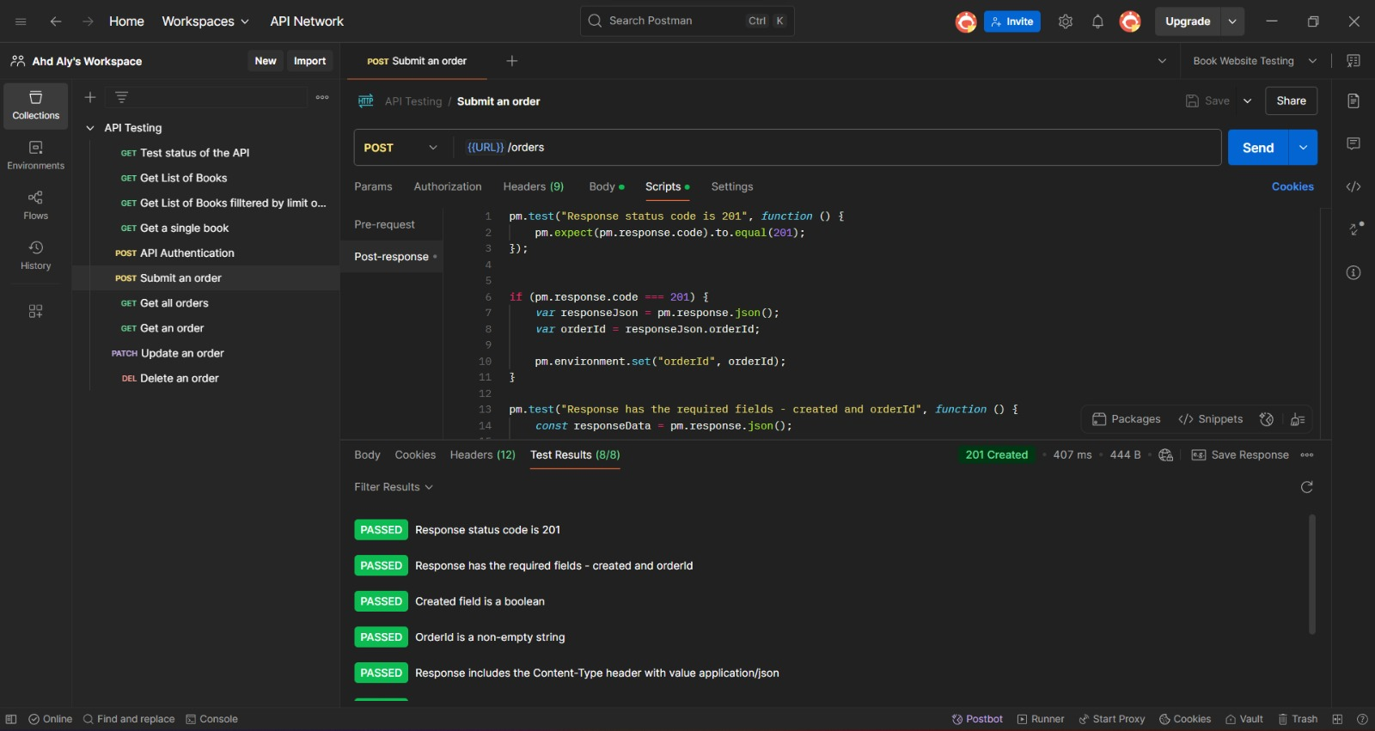

Slide 18
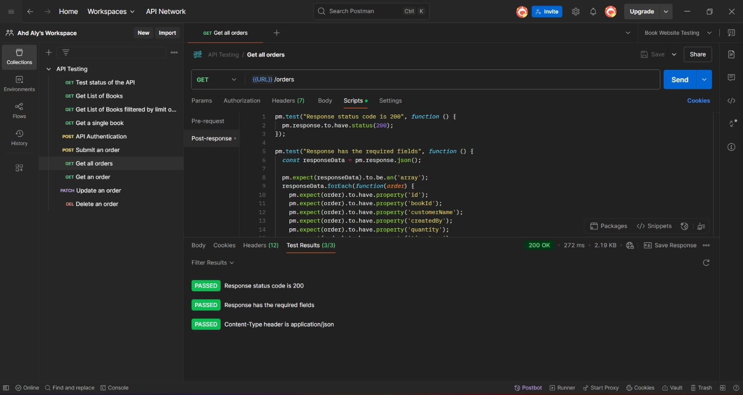

Slide 19
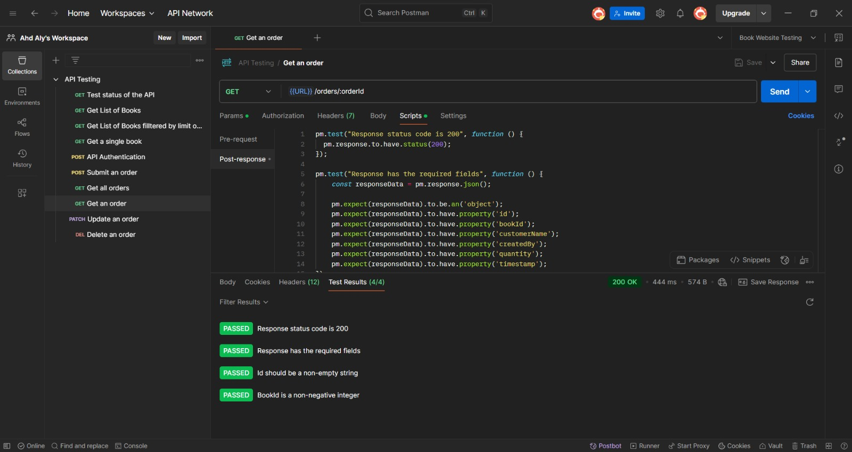

Slide 20
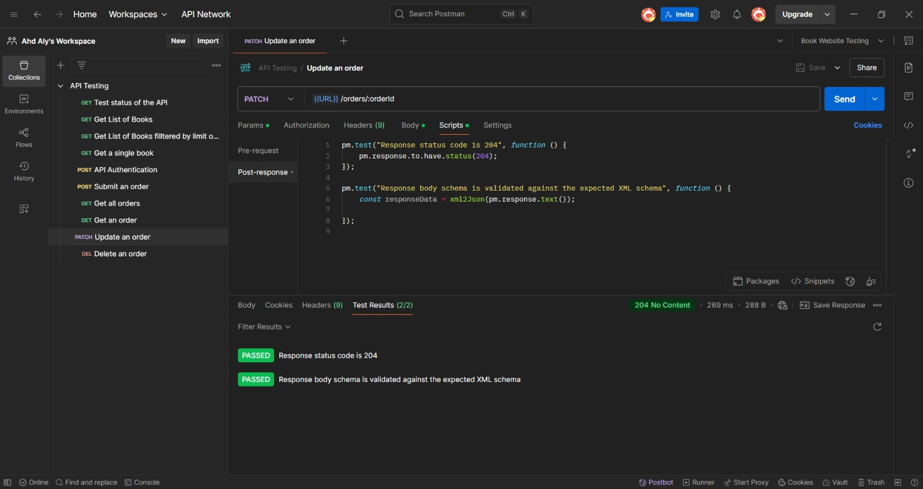

Slide 21
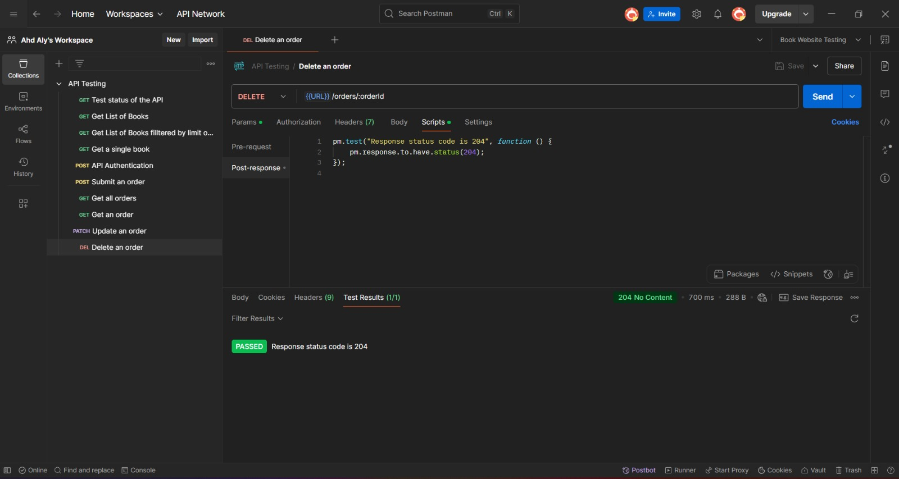

Slide 22
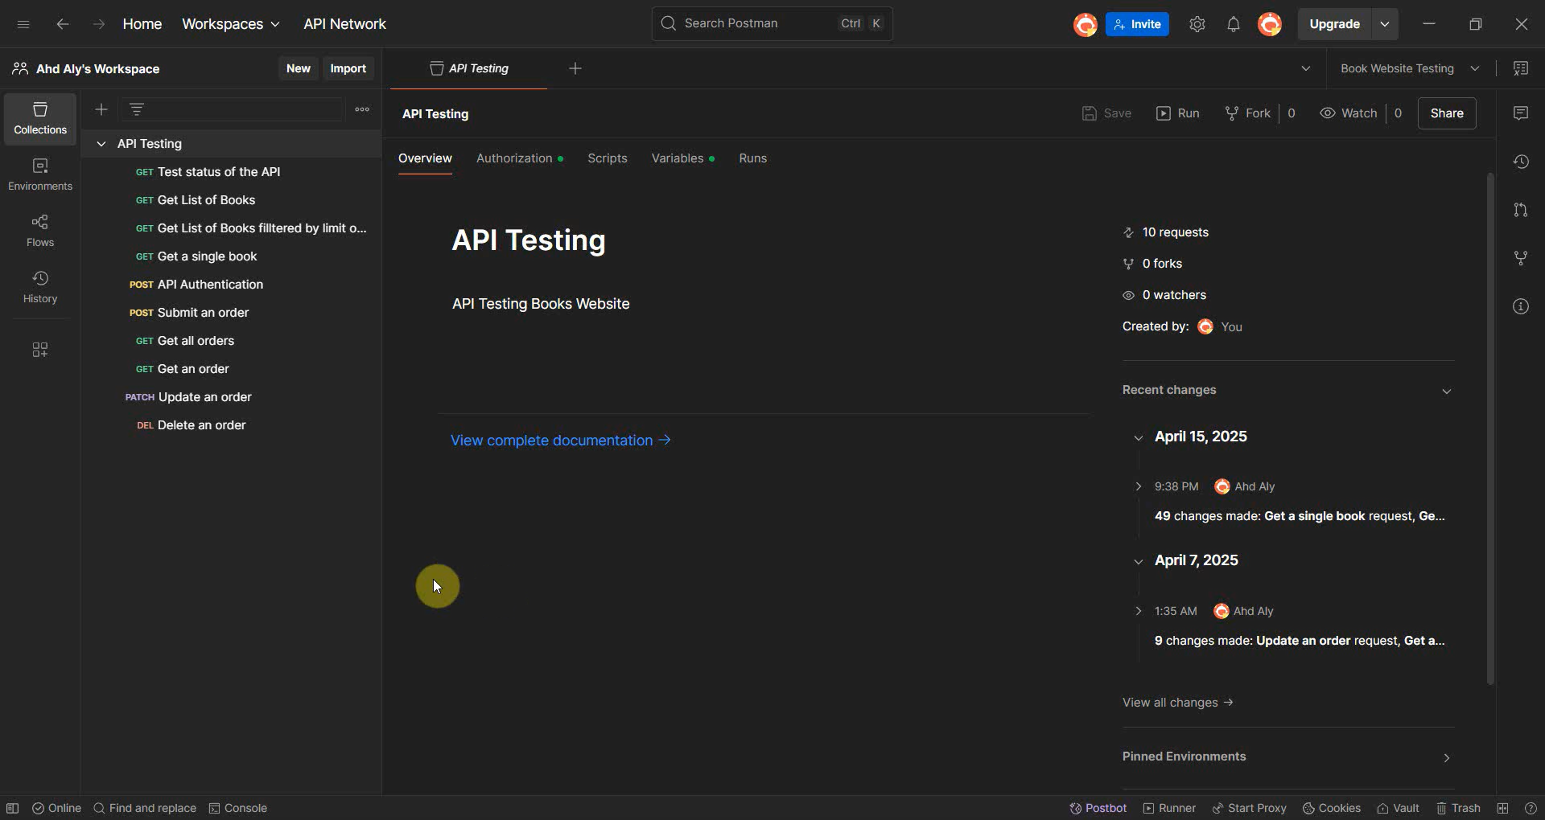

Slide 23
Automation Testing:
E-commerce Websites
( Demoblaze/Amazon )
Selenium WebDriver
Test Scenarios
Automate user journeys like product search, cart management, and checkout process.
Utilize Selenium for cross-browser automated testing of e-commerce functionalities.

Slide 24
Tools & Configuration:
✅ Selenium WebDriver Used for automating browser actions.
✅ Google Chrome + ChromeDriver WebDriver configured with browser path &
driver path.
✅ IDE: IntelliJ Used for writing & running scripts.
✅ Programming Language
Java

Slide 25
Demoblaze Website
Positive Test Scenario:
This automated test scenario validates the end-to-end functionality of a typical user journey on Demoblaze.com, starting from user login through to completing a purchase.

Slide 26
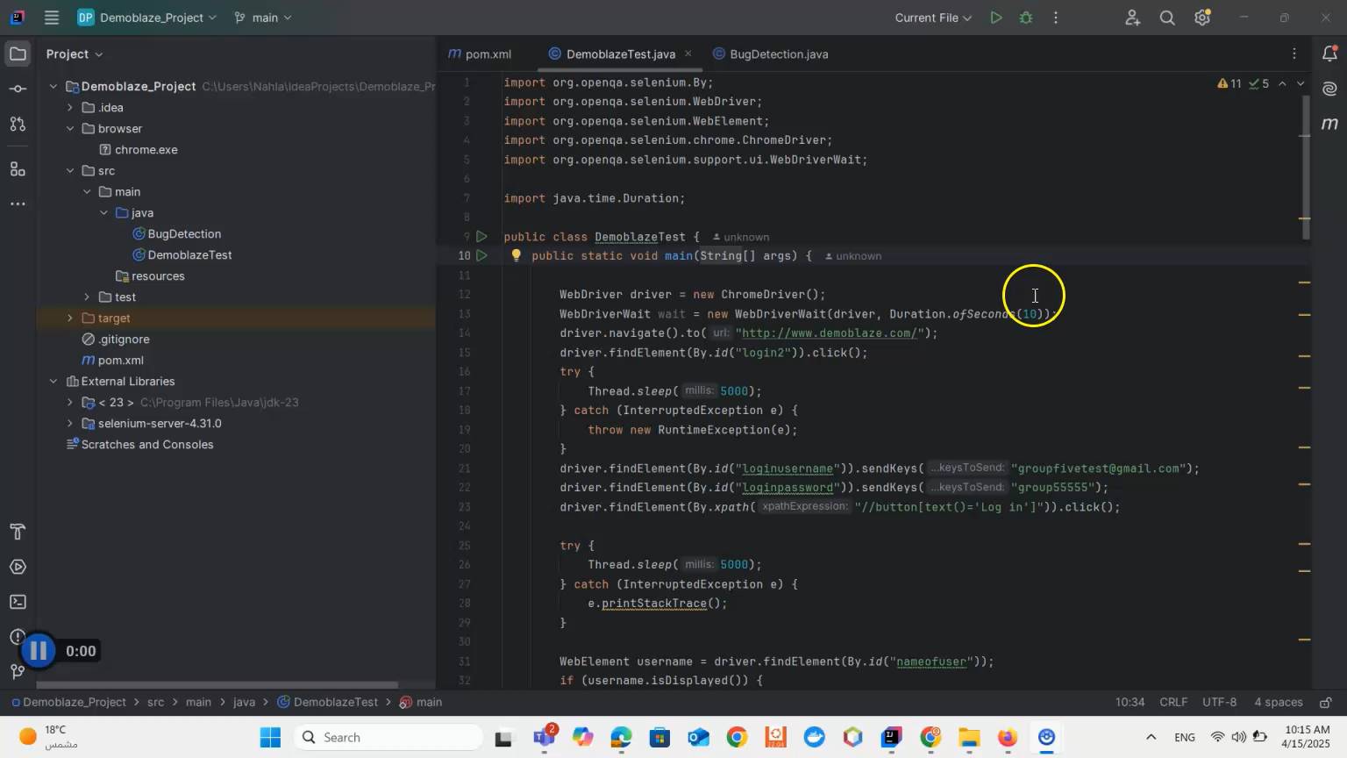

Slide 27
Demoblaze Website
Negative Test Scenario:
This automated test scenario validates the end-to-end functionality of a typical user journey on Demoblaze.com, starting from user login through to completing a purchase. focusing on handling invalid inputs at various stages to ensure error handling and input validation.

Slide 28
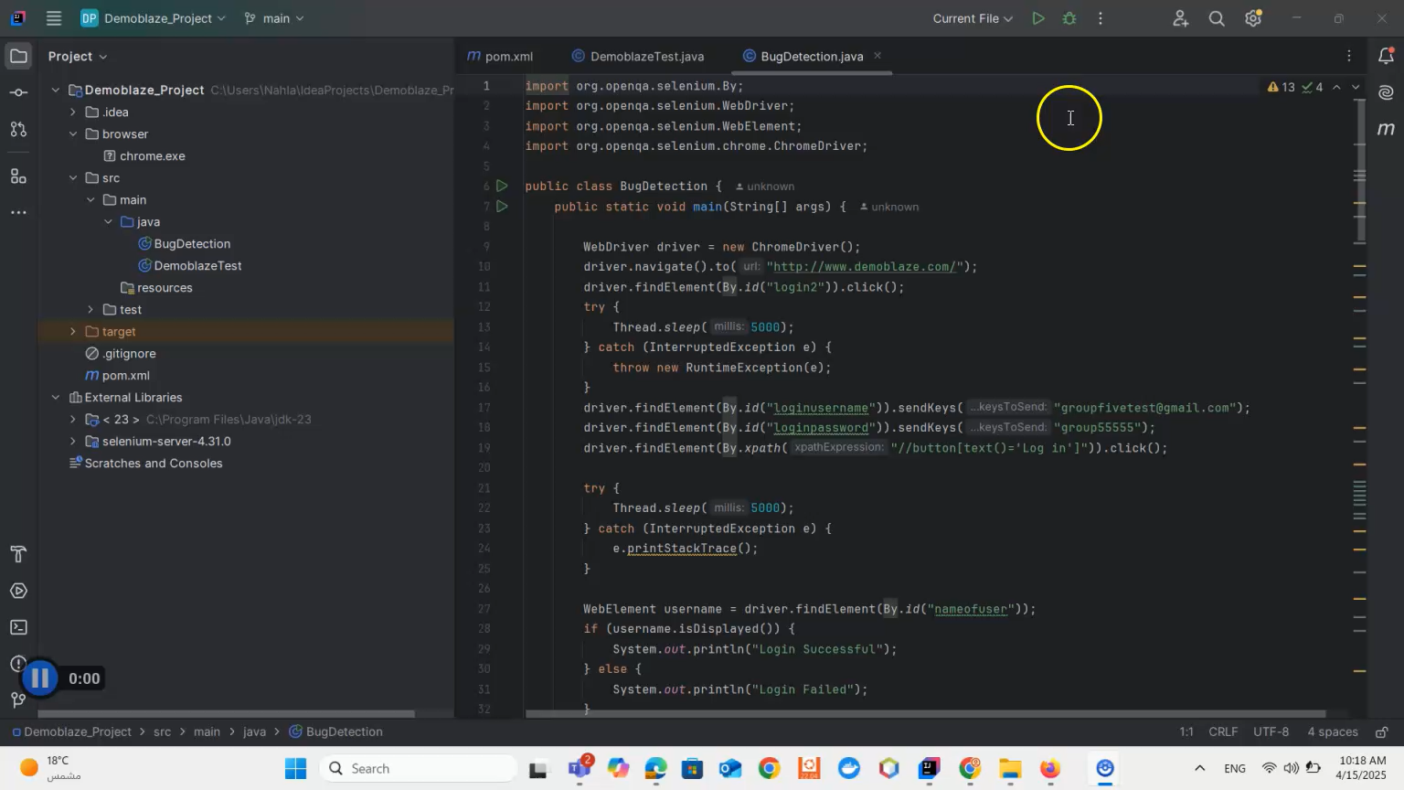

Slide 29
Amazon Website
automation script on amazon.com
- Open Amazon site
- Navigate to Amazon Fashion
- Apply Male Filter
- Select a Product
- Add to List

Slide 30
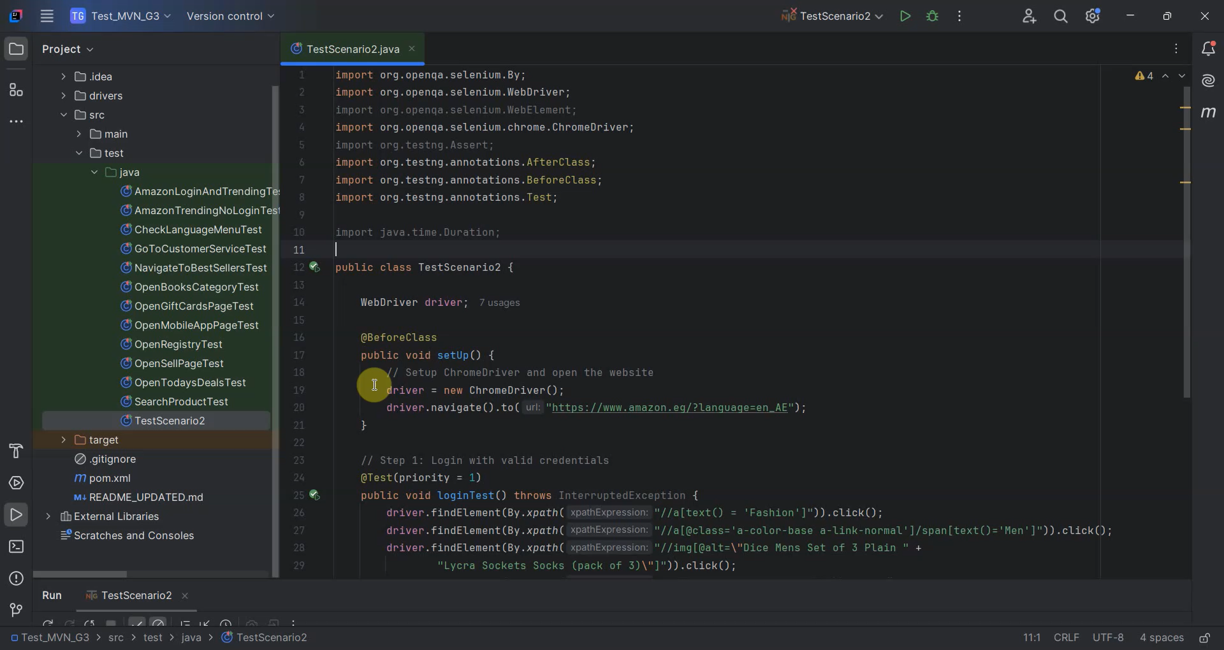

Slide 31
Thank You

